Slide 1
1_Light up your LED

Slide 2

How to Light Up your LED
If key not be pressed, the FPGA give the 3.3V current to LED, and LED is connected to 3.3v, no voltage difference so LED wouldn’t be light up.
If key be pressed, the FPGA give the 0V current to LED, LED would be lighting up.
KEY
LED

Slide 3
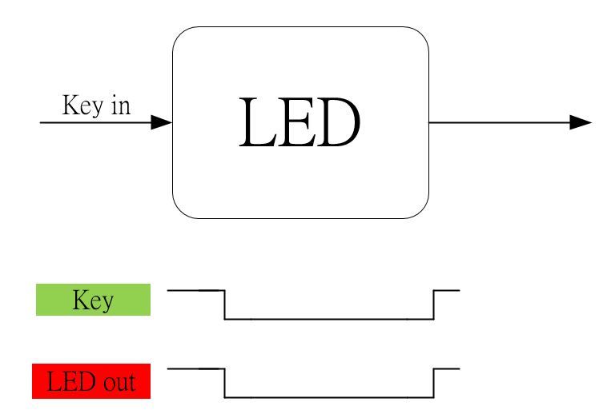
Waveform Graph

Slide 4

Waveform Graph - Simulation

